Slide 1
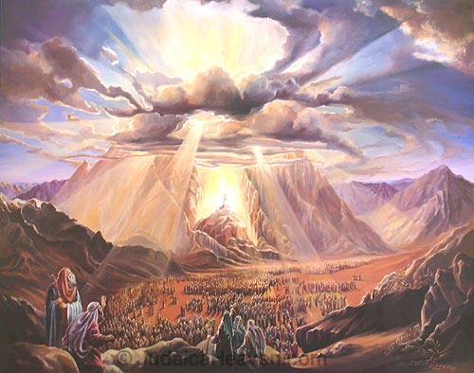
The Tabernacle of Moses
God’s Outreach Ministry Int. Inc. ©
G-D wants to dwell among His people!
It’s historical from the Book of Exodus.
There are deep “spiritual” insight and pictures inside!
The picture of the Tabernacle; and the agony sacrifies of Yeshua
How you can enter the Holy of Holiest and to experience to be face to face to the very G-D Himself!

Slide 2
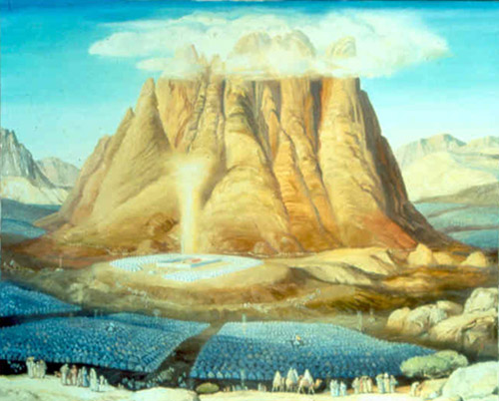
The Story about the Tabernacle, The tent of Meeting with G-D in the Dessert!

Slide 3
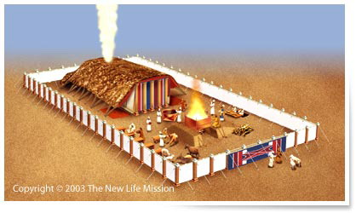
The very G-D of Israel who wants to live among His people
God wil wonen midden tussen zijn volk!

Slide 4
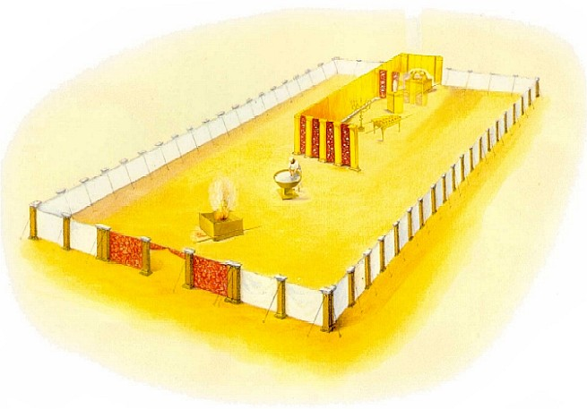
De Tabernacle was made by the gifts of G-D’s people.

Slide 5
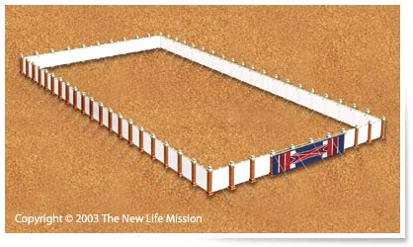
The tabernacle was saperated from the world, by this ‘fence’!
Het hout kwam van een “knoerharde” acaciaboom,niet mee te werken!
Zo kan God van iets slechts…toch iets heel goeds maken!

Slide 6
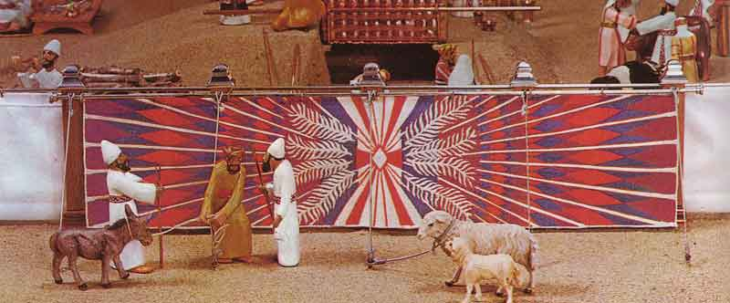
The entrance of the Tabernacle Yeshua declared: I am the {only} way!

Slide 7
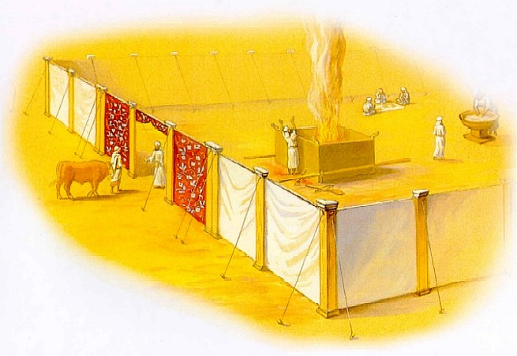
No-one can come to My Father only through Me!

Slide 8
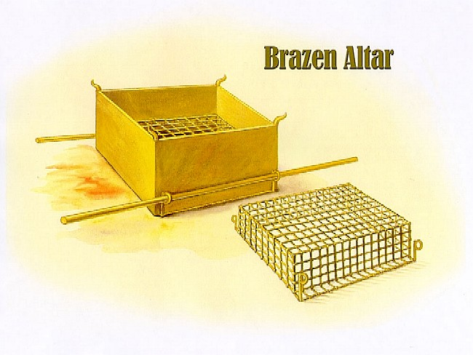
Your first entrance is the “Brazen Altar”! Referring to the Cross of Yeshua!

Slide 9
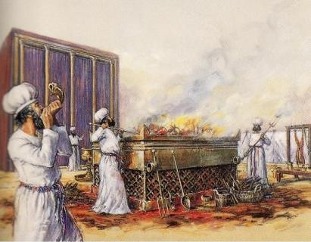
The altimade sacrify of Yeshua Messiah!
A place of repentance and reconcilliation!

Slide 10
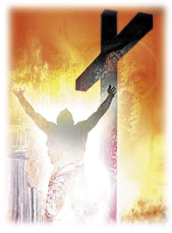
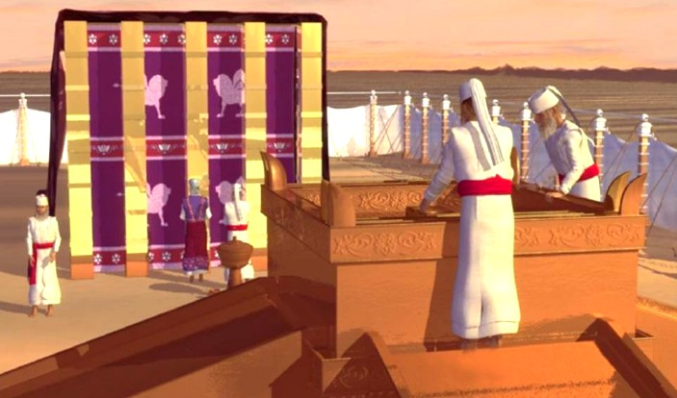
The altimade sacrify of Yeshua Messiah! A place of repentance & reconcilliation! COMING TO THE CROSS of Yeshua Messiah! Melchisedec = High Priest (Hebrews 9:14;,15; 1-5)

Slide 11
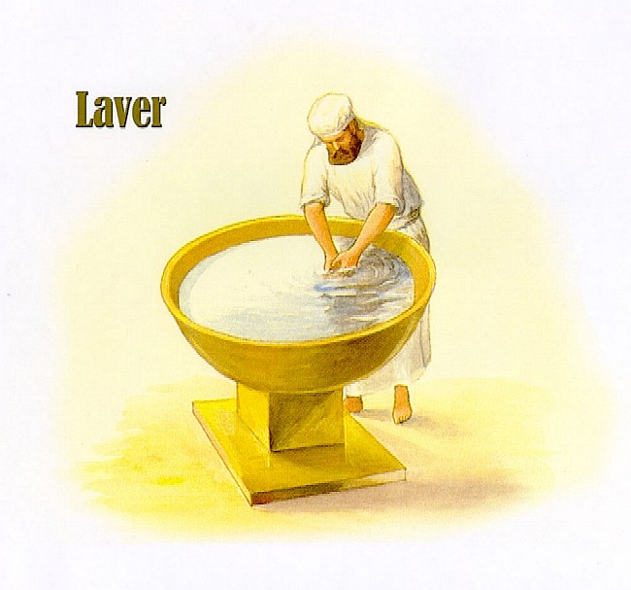
The “Laver of Water” washing “yourself” your hands & feets.

Slide 12
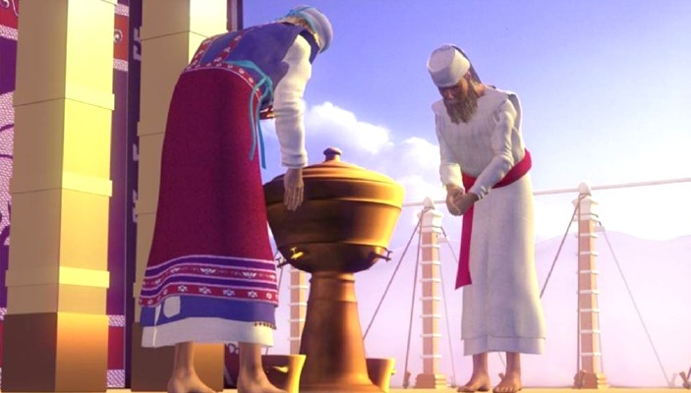
Symbolic for cleaning yourself into the “Word” of G-D!

Slide 13
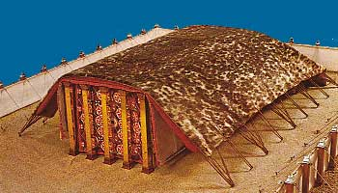
The tent of meeting “Face ot face with G-D”!

Slide 14
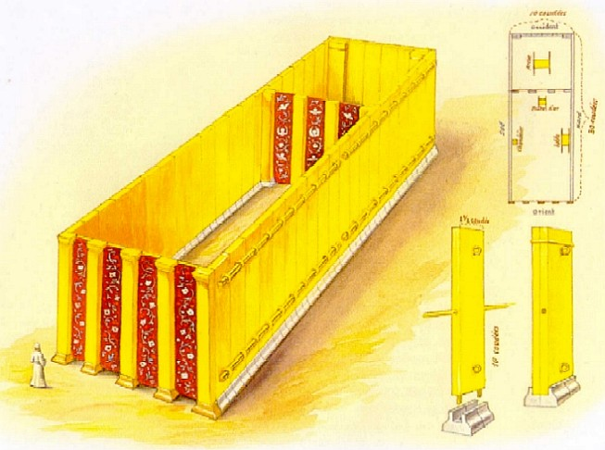
It was wood overlayed with gold

Slide 15
The wooden pales were overlayed with pure gold; the feets were from silver!
De planken stonden op een zilveren fundament. Onze grondslag is dat we gekocht en betaald zijn door Jezus!

Slide 16
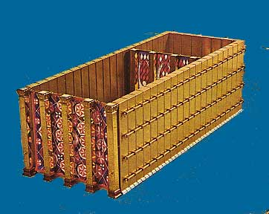
Together they formed the Tabernacle of G-D!
West
South
North
East

Slide 17
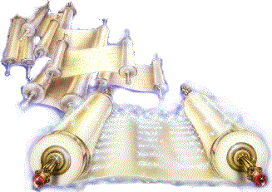
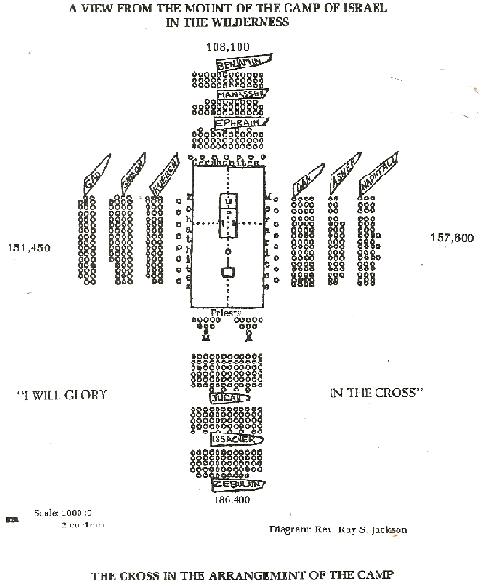
West
South
North
The cross in the arrangement of the tribes at the Camp in the wilderness around the Tabernacle!
East
Source: "The Tabernacle of MOSES" by Kevin Conner; Between Pg 12-14

Slide 18
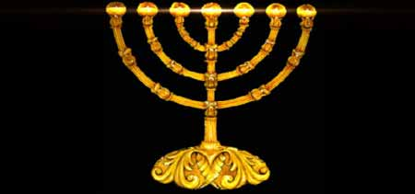
On the south-side there was the Menorah... Yeshua Said: “I am the Light of the world”. The oil in the lamps referring to the Holy Spirit!

Slide 19
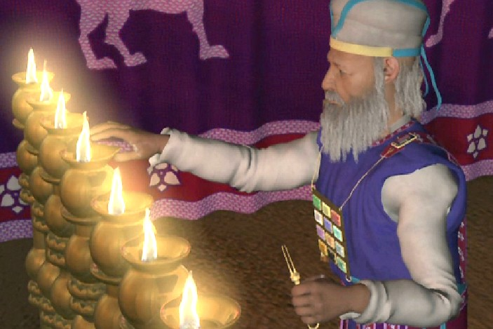
No language can describe the Glory of the scene presented within the sanctuary--the gold-plated walls reflecting the light from the golden candlestick (Jewish Menorah),

Slide 20
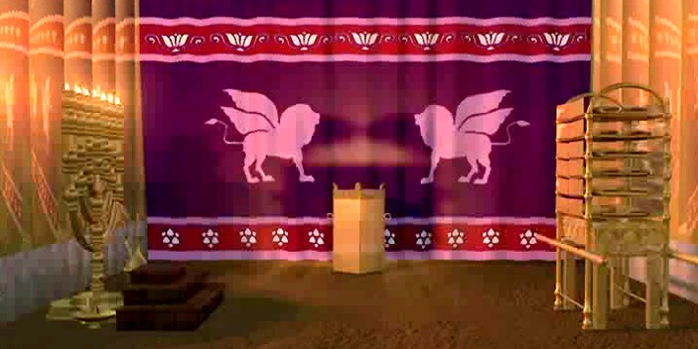
The brilliant hues of the richly embroidered curtains with their shining angels, the table {with the showbread}, and the altar of incense, glittering with gold; beyond the second veil the sacred ark, with its mystic cherubim, …

Slide 21
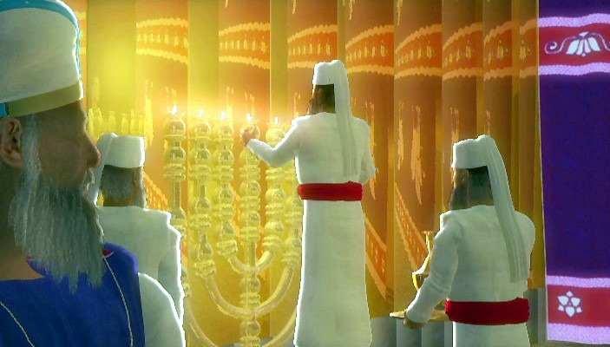
Above it the Holy Shekinah, the visible manifestation of YHWH's presence; all but a dim reflection of the Glories of the Temple of G-D in Heaven, the great center of the work for man's redemption!

Slide 22
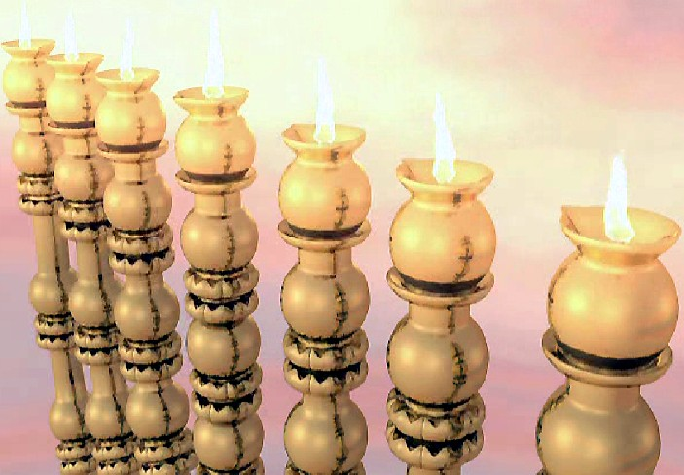
The Lamp-stand-Menorah provided light in this
otherwise dark 'Holy Place'!

Slide 23
The Priests trimmed the wicks to keep them burning brightly! This Menorah was made from a single piece of gold! It was not pieced together! It had a central shaft.

Slide 24
The Menorah represents the work of the Holy Spirit! Part 1
As the Menorah was hammered out of a rock and the other lights where fixed to the center to the foot, so the Holy Spirit will "hammer us"; so to speak! He will purify us and cleans us and remove the flesh so we will die to self and He will be the King of our life's! Yeshua/Jesus Son of a Carpenter!

Slide 25
The Menorah represents the work of the Holy Spirit! Part 2
We will look as pure gold! And we will be one with Him! As the Menorah stood before the Holy of Holies it represents that if we are not dead on self we cannot enter His heart! Flesh will not see our King and cannot enter His Throne! When gold is at the highest melting point it will be as clear as glass!
(that demands enormous heat)

Slide 26
The Menorah represents the work of the Holy Spirit! Part 3
If the Lord has achieved our melting process we will be as pure as gold and being transparent! Who will help us to continue this process? Who is the craftsman who work in us and through us? The Holy Spirit!

Slide 27
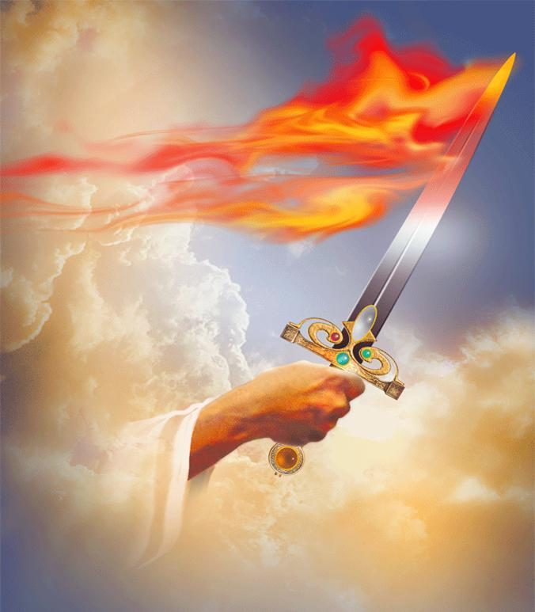
Purified through the All-Consuming FIRE of YHWH!
The FIRE of the living G-D burns these things deep in our hearts, IF we allow the Holy Spirit to do this tremendous work! Break up your fallow ground. (Hosea 10:12) It’s time to allow the Holy Spirit to touch us and make this ground soft and ready for the seeds. Breaking every stronghold in Yeshua’s Name! Break the power of satan over every life! Break every resistance and release the POWER of G-D!
Yes, the All-consuming FIRE of G-D
will burn, deep, deeper in our hearts
so that every religious spirit will be burned and consumed!
God’s Outreach Ministry Int. Inc. ©

Slide 28
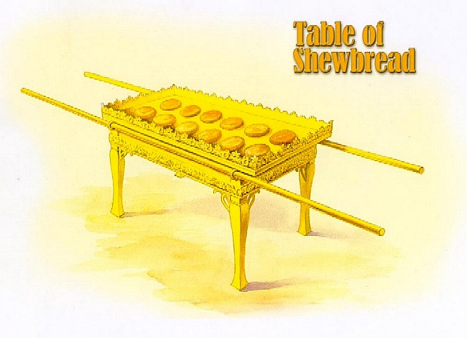
The Table of 12 Shew-Breads; refering to each tribe of Israel
God’s Outreach Ministry Int. Inc. ©

Slide 29
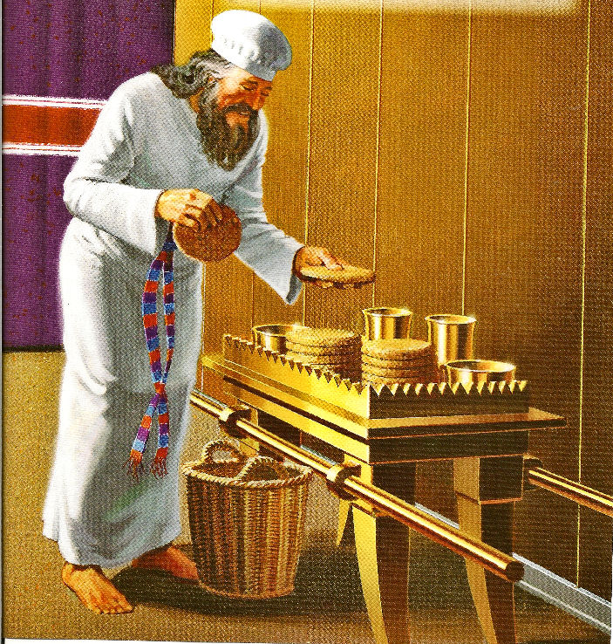
God’s Outreach Ministry Int. Inc. ©
The Table of 12 Shew-breads.
Yeshua is the Bread of life

Slide 30
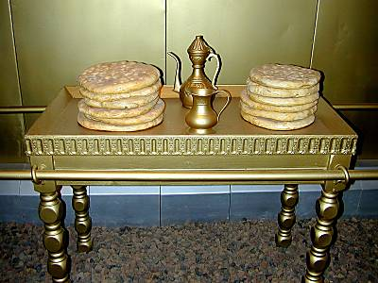
Yeshua replied, I am the Bread of Life. He who comes to Me will never be hungry, and he who believes in {and} cleaves to {and} trusts in {and} relies on Me will never thirst any more (at any time). (John 6:35)
God’s Outreach Ministry Int. Inc. ©

Slide 31
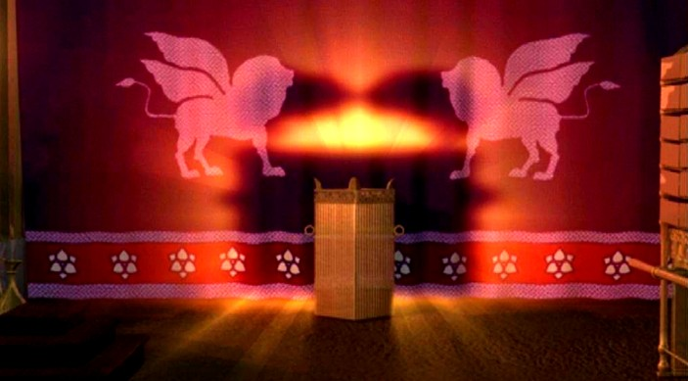
The smoke of the Golden Altar of incense; The prayers of the saints lifted up before the Throne of G-D!
God’s Outreach Ministry Int. Inc. ©

Slide 32
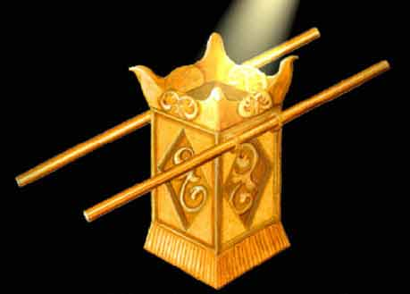
There are 11 kind of prayers in the New Covenant! The Prayer of...
1 | Confession of sin | 1 John 1:9
2 | Confession of fault | James 5:16
3 | Agreement | Mat. 18:19
4 | Faith for the sick | James 5:15
5 | Binding | Matt. 16:19
6 | Loosing | Matt. 16:19
7 | ...in the Spirit | Eph. 6:18
8 | your understanding | 1 Cor. 14:15
9 | Thanksgiving | Phil. 4:6
10 | Intercession | 1 Tim. 2:1
11 | General Supplication | Phil. 4:6
 | Smoke of the incense | Revelation 8:3-4
The smoke of incense; The prayers of the saints
God’s Outreach Ministry Int. Inc. ©

Slide 33
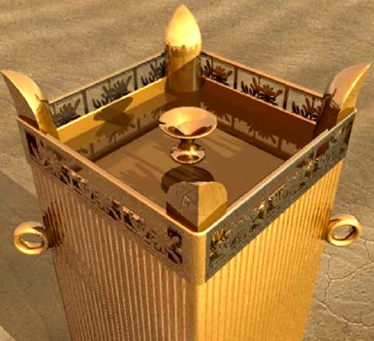
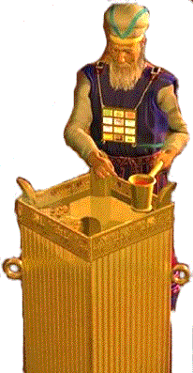
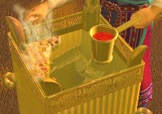
East
North
South
West
In the center, at the west-end of the Holy place, and just before the 'door-hanging' of the Holy of Holies is standing the Golden Altar of smoke-incense, a situation of higher honor than that of any other of the secret vessels there is yet to considered, being regarded as immediately before the 'Throne' itself, even though the veil intervened. (Exodus 30:6) It was made of acacia wood and overlaid with gold. (Exodus 30:3) Two rings for the gold-covered staves passing through, by which is was carried - corner-wise, and was so placed in the Holy place, presenting to one entering a corner and not a side! So the horns of the Altar might point to each of the four great armies (tribes) of Israel encamped around the Tabernacle! (West-East-North-South…)(Exodus 30:4)
God’s Outreach Ministry Int. Inc. ©

Slide 34
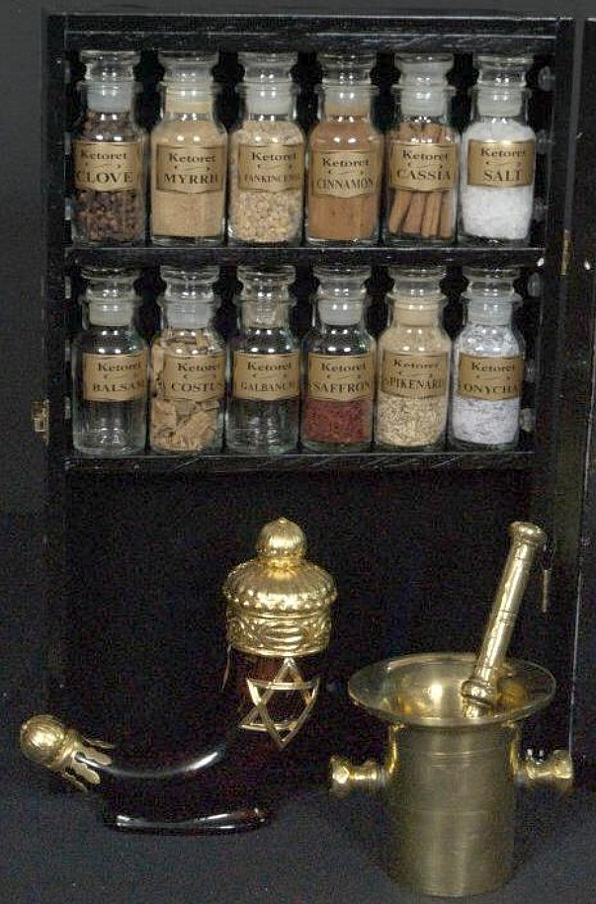
The smoke of insence and including the spycies; are referring the the sacrificial intercessions of the righteous saints
God’s Outreach Ministry Int. Inc. ©

Slide 35
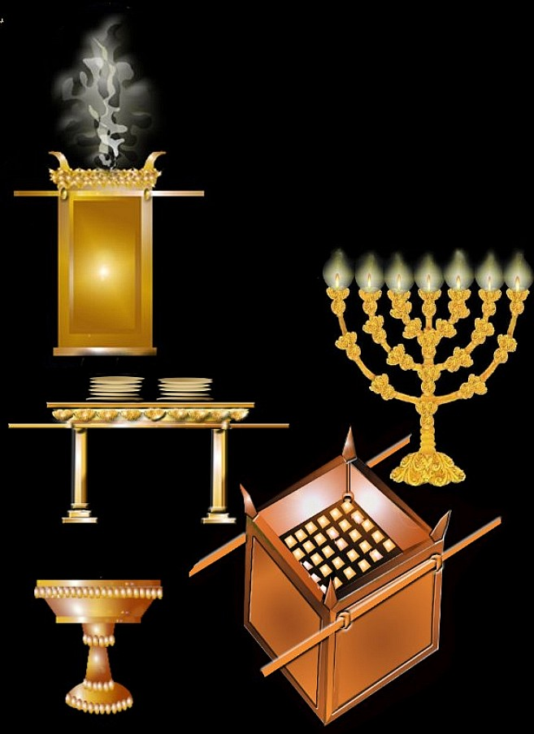
On our way the G-D
of Israel we passed:
Altar (Bras) of Sacrifies
The Laver (Brass) of water
The Golden Menorah.
The table of showbreads.
Altar of Smoke-Insence.
5
3
4
God’s Outreach Ministry Int. Inc. ©
2
1

Slide 36
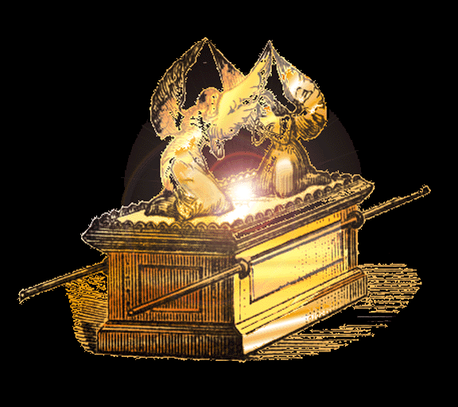
The Ark of the Covenant of G-D!
...In the Holy of Holiest
L

Slide 37
L
The Ark of the Covenant of G-D!
...In the Holy of Holiest

Slide 38
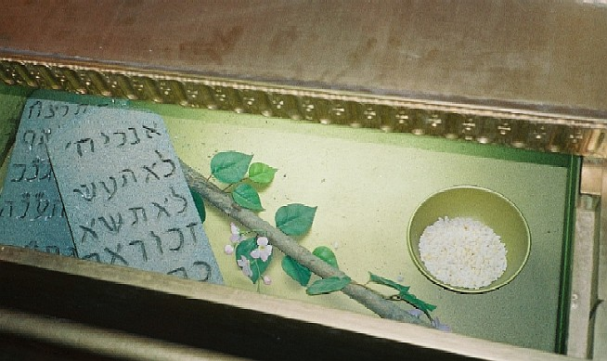
The Manna from Heaven; The rod of Aäron, the stone tablets of the 10 Commandments inside the Ark!
The Law = The Way
The Manna = The truth
The Rod = The life
God’s Outreach Ministry Int. Inc. ©

Slide 39
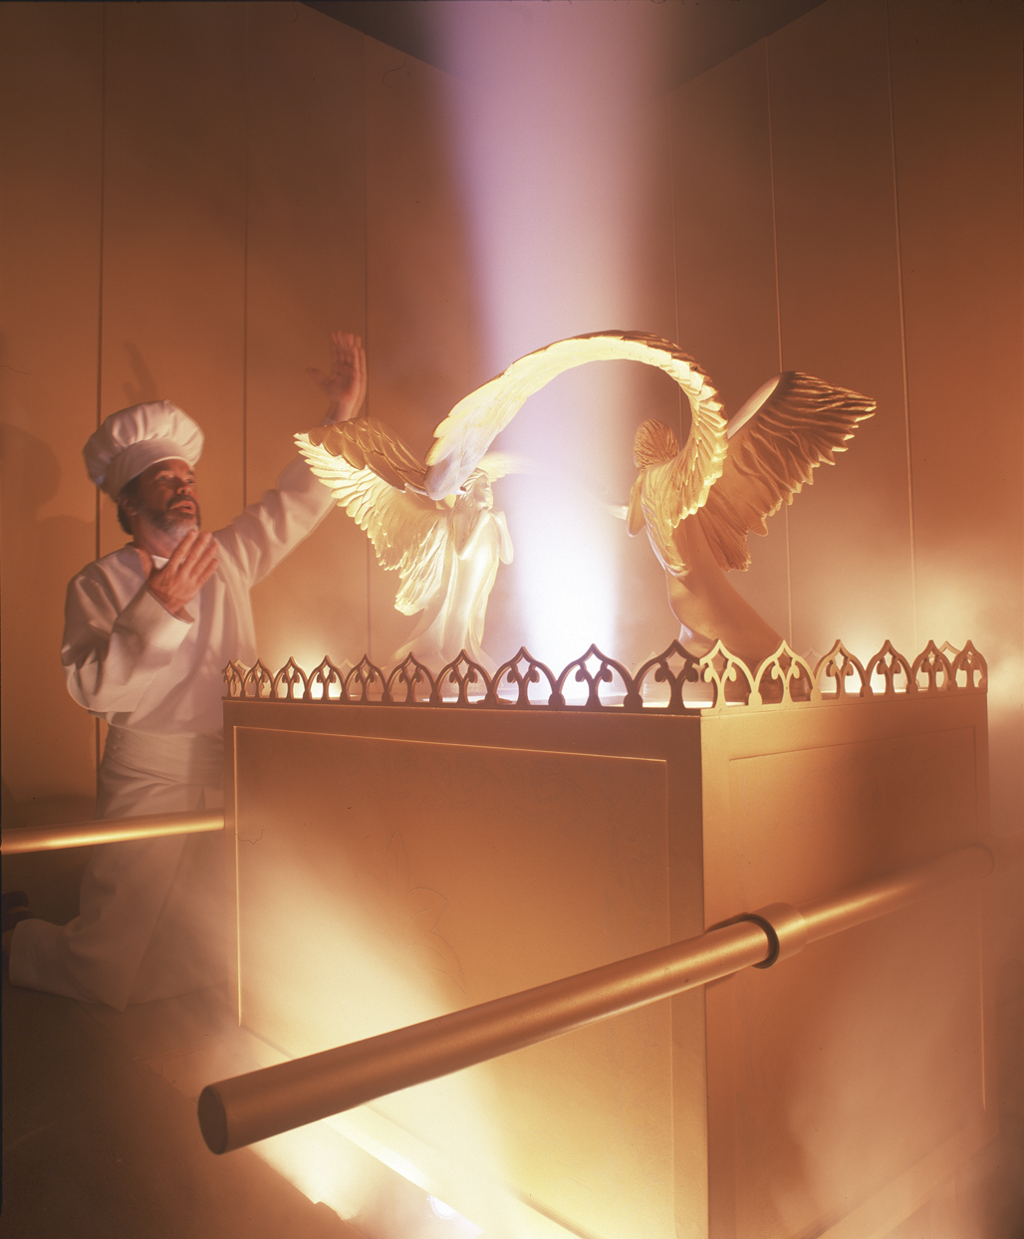
“The skekinah” Glory of G-D!
God’s Outreach Ministry Int. Inc. ©

Slide 40
“The skekinah” Glory of G-D! 1
The Atonement 1
The Merci Seat was all of gold. Solid gold makes it very costly, but that which would applied on it, the Blood (of Yeshua..symbolic; and later on the cross) of the Atonement is priceless! (Romans 3:25a). The Cherubim on the Merci Seat are symbols of power; authority & guardianship, the ultimate in assurance and security. It speaks of Yeshua Messiah as the assured, unequivocal authority & power. …the Atonement…
God’s Outreach Ministry Int. Inc. ©

Slide 41
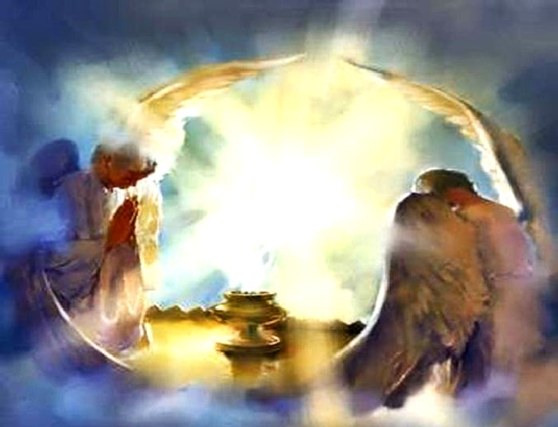
“The skekinah” Glory of G-D! 2
The Atonement 2
The Blood has been applied, the Shekinah Glory has come, The Lord-G-D Elohimאלהים has excepted the sacrifice and no power in Heaven or earth or under the earth can change it! The Cherubim were to look one to the other toward the Merci Seat; Agreement & unanimity; with outstretched wings, they reveal agreement and assume a posture of protection.
God’s Outreach Ministry Int. Inc. ©

Slide 42
“The skekinah” Glory of G-D! Atonement 3
Yeshua Messiah (Grace) has fulfill the demands of the law through the shedding of His own Blood.
The law condemned everyone. Only Yeshua could fulfill the law. Only the golden lid with the Cherubim and having the Blood applied, could keep men from judgment from the law. Yeshua Messiah (Grace) has fulfill the demands of the law through the shedding of His Blood. The lid and Cherubim that covers and meet the demands of the law. (Matthew 5:17)
God’s Outreach Ministry Int. Inc. ©

Slide 43
“The skekinah” Glory of G-D! 4
The Atonement 4
G-D's Holiness & Justice, was the applied Blood
When the High-priest approached, only the Merci Seat on the Ark was in view and not the law. Between the law and Shekinah Glory, G-D's Holiness & Justice, was the applied Blood. The High priest was safe with the atoning Blood for G-D looked upon the Blood and could forgive! The Blood could now speak 'Grace' rather than judgment for the sinner! (Exodus 25:21, 22; Hebrews 10:19-22)
God’s Outreach Ministry Int. Inc. ©

Slide 44
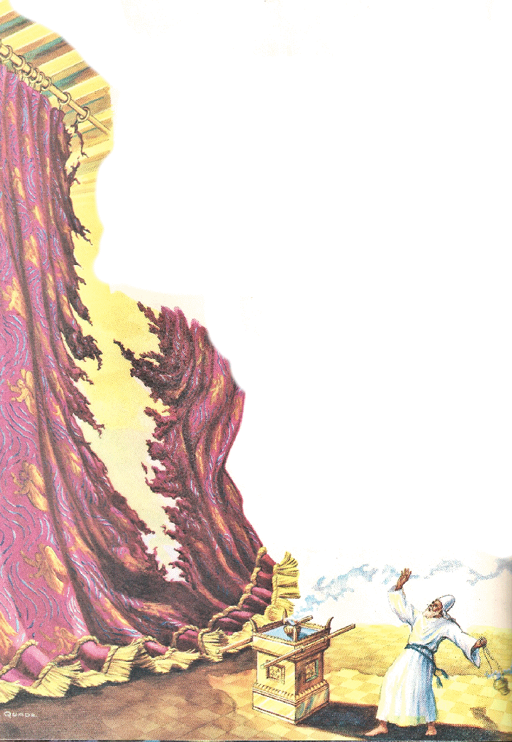
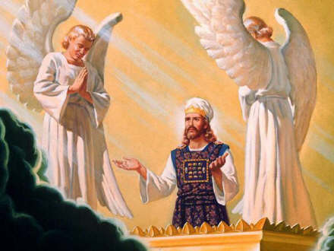
Yeshua is now interceding in our behalf as our High Priest in the Heavenly Temple of G-D!
The Atonement 5
God’s Outreach Ministry Int. Inc. ©

Slide 45
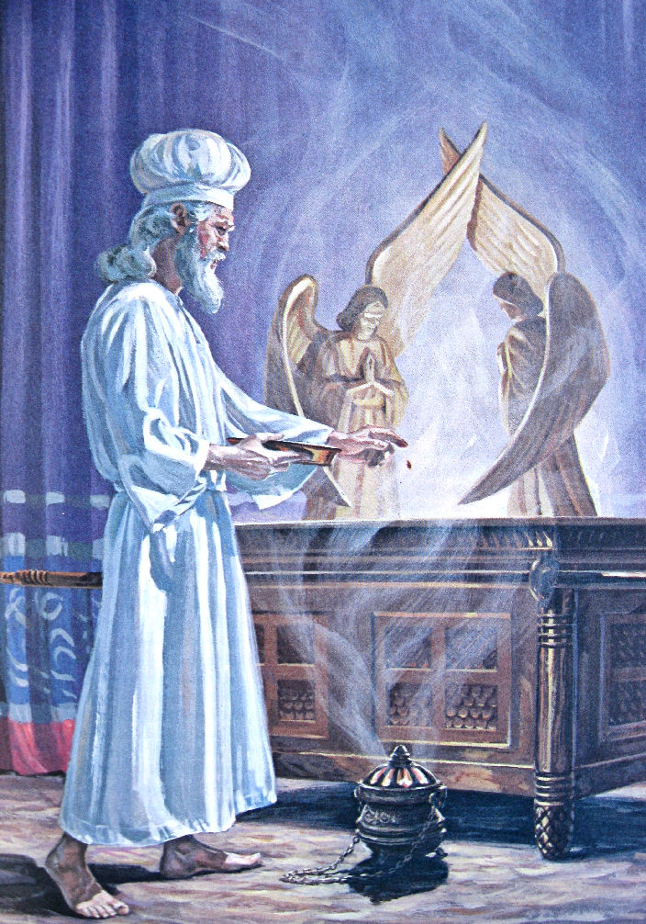
The Atonement 6
"The breath of the Holiest"
In preparation, the high priest would separate himself from his family & from the Israelites for 7 days in a chamber at the Temple. On the special Day of Atonement, he came forth dressed in 4 linen garments:
A linen robe with long sleeves that draped to the ankles.
A linen belt that tied around the waist.
A pair of linen breaches.
A line turban that fit around the head, covering his hair.
God’s Outreach Ministry Int. Inc. ©

Slide 46
The Atonement 7
"The breath of the Holiest"
When G-D came down in the Tabernacle in the time of Moses, the curtains will be expand like a men's longs and a breathing sound was been heard. This sound of breath was called:
"The breath of the Holiest": "Breath" is "Roach" in Hebrew. The Ruach Ha Kodesh; The breath of the Holy Place! Breath' means Spirit and became as the Holy Spirit!
God’s Outreach Ministry Int. Inc. ©

Slide 47
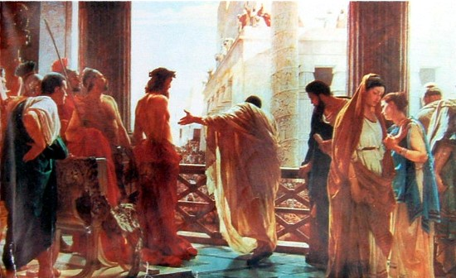
The Atonement 8
“7 times the Blood was sprinkled on the Ark“
“7 times the Blood was shed from 7 different part of Yeshua’s body
From His FACE, where His sweat became Blood!
From His HEAD, where the soldiers placed a crown of thorns!
On His BACK, where the soldiers beat Him with a 12-fold whip!
His LEFT HAND where the spike was driven into the flesh!
His RIGHT HAND where the spike was driven into the flesh!
His FEET, that where nailed together!
His SIDE, where the spear pierced Him!
God’s Outreach Ministry Int. Inc. ©

Slide 48
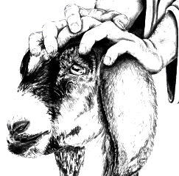
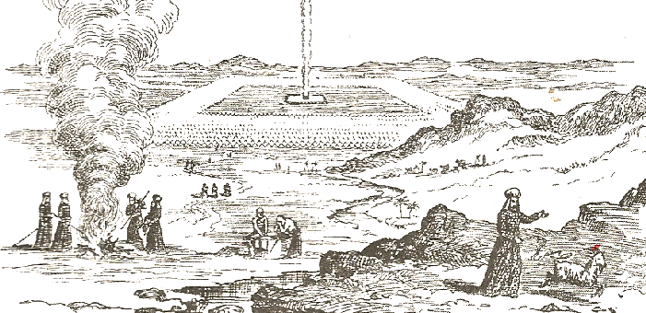
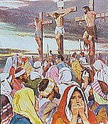
The Atonement 9
3 RED THREADS; 3 CROSSES!
Tied to the horns of the goat: “for the L-rd”!
Tied around the horns of the goat: “for Azazel”!
Red thread was tied to the temple doors; turned white when G-D saw the completed sacrifice
3 RED THREADS; 3 CROSSES!
YESHUA was dying as an offering: “for the L-rd”!
A THIEF died rejecting Yeshua and he went to hell!
Another THIEF “changed” on the cross, his scarlet sins becoming white as snow!
God’s Outreach Ministry Int. Inc. ©

Slide 49
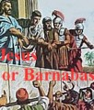
The Atonement 10
YESHUA…!
Died on the cross, representing: “the goat that died on the brass altar” on the Day of Atonement!
Barabbas…!
Was released, but carried his sins with him, just as: “the scapegoat (Azazel) bore the sins of Israel into the wilderness”!
God’s Outreach Ministry Int. Inc. ©

Slide 50
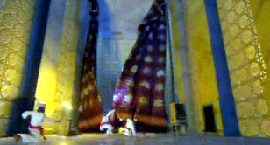
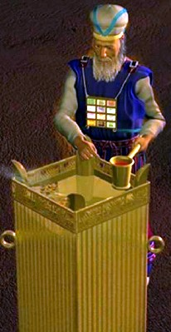
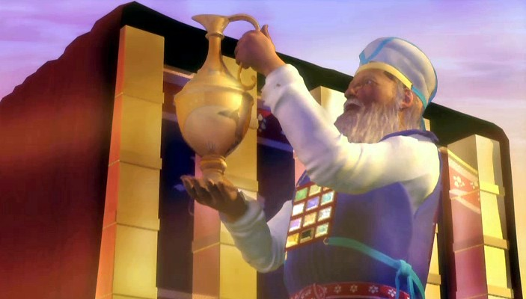
The Atonement 11
Beyond the inner veil was the Holy of Holies, where centered the symbolic service of atonement & intercession, and which formed the connecting link between Heaven and Earth!
God’s Outreach Ministry Int. Inc. ©

Slide 51
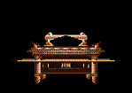
The Atonement 12
For His Divine rule in the hearts of those who acknowledge Him as Sovereign Lord! Yeshua had to beaten to get mercy for us! (Hebrews 5: 8-10; 9: 3-8) Receiving by grace His Glory and being in His Divine presence!
God’s Outreach Ministry Int. Inc. ©

Slide 52
The Atonement 13
Each aspect of the crucifixion is a scene from the past; a type from the OT Law being acted out and fulfilled by Yeshua Messiah Himself! We would look in vain in the New Testament Scriptures for a fulfillment by the Church (-age), because the Church owes no atonement. "She" is not innocent, but exonerated. Now Yeshua has paid all our sins! Yeshua Messiah is our High Priest as declared in:(Hebrews 4:14-16)
God’s Outreach Ministry Int. Inc. ©

Slide 53
The Atonement 14
By the Atonement made this day for Ancient Israel, the barriers standing in the way of their approach to G-D were removed, so that they may now approach Him through the medium of the “High Priest”! The way of access being open!
God’s Outreach Ministry Int. Inc. ©

Slide 54
Between the cherubim, G-D made known His will. Divine messages were sometimes communicated to the high priest by a voice from the cloud. Sometimes a light fell upon the angel at the right, to signify approval or acceptance, or a shadow or cloud rested upon the one at the left to reveal disapproval or rejection.
God’s Outreach Ministry Int. Inc. ©

Slide 55
“The veil before the Holy of Holiest torned in two parts !
Yeshua is now our High Priest in the Heavenly Temple of G-D!

Slide 56
Yeshua said to him, I am
the Way and
the Truth and
the Life;
no one
comes to the Father except by (through) Me! (John 14:6)
The Law = The Way
The Manna = The truth
The Rod = The life
God’s Outreach Ministry Int. Inc. ©

Slide 57
G-D provided us the way to Heaven through His Son Yeshua!
The Way through Yeshua, His Blood, the cleansing, The Word, Worship, praise, Humility, trust in, G-D’s Laws & Statutes….
God’s Outreach Ministry Int. Inc. ©

Slide 58
Now, the Holy Spirit is send to us as a conforter!
God’s Outreach Ministry Int. Inc. ©

Slide 59
End-Time-Harvest-Revival
www.Endtimeharvestrevival.org
This power Point presentation is created by:
Paulus van Beek
Use the sickle, for the time has come for you to harvest; the crop is ripe on the earth." Revelation 14:15
God’s Outreach Ministry Int. Inc. ©
P. O. Box 93404 Lakeland; Florida; USA (863)-660-2444

